Slide 1
CSCI -112 Introduction to computer Systems
LAB
Instructor: Santanu Banerjee

Slide 2
Conditional and Unconditional Jumps

Slide 3
Exercise
Conditional and unconditional jumps
Read the exercise instructions carefully
Complete the exercises
Total 24 points

Slide 4
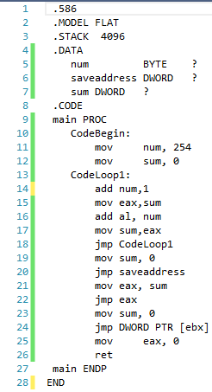
Exercise: Unconditional jump
Use the code in console 32 type assembly project.
Build the project.
Identify the 4 jump instructions in the code and the listing file.
Answer the following for each of the jump instructions.
The complete object code
The opcode
The byte- length
Type (one of “relative short”, “relative near”,”register indirect”, “memory indirect”
8 points( .5 x 4 x 4)

Slide 5
Exercise: Unconditional jump (8 pts)
Line# | Complete Object Code | Op code | Object code length (in byte) | Type

Slide 6
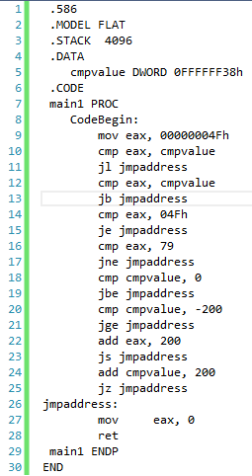
Exercise : Conditional jump
Use the code in console 32 type assembly project.
Build the project.
Identify the 8 jump instructions in the code and the listing file.
Find and submit the following for each of the jump instructions.
The complete object code of the jmp instruction.
The complete object code of the preceding cmp instruction
Flag(s) condition(s) that is(are) checked for making the decision to jump or not.
Examine the code and indicate (Yes/No) whether each of the statements will cause a jump(when the program runs).
16 points( .5 x 4 x 8)

Slide 7
Exercise: Conditional jump(16 pts)
Line# (jmp) | Complete Object Code(jmp) | Complete Object Code(cmp/add) | Flag(s) Condition | Jump? (Yes/No)

